Slide 1
FindLeft (P, d)
If (P is not in a cluster){
P = point with previous timestamp // (P.timestamp--)
FindLeft (P, d);
}
return P;
End
FindRight (P, d)
If (P is not in a cluster){
P = point with next timestamp // (P.timestamp++)
FindRight (P, d);
}
Return P;
End
Clustering-Dispersion (Threshold d)
Remove all rows with confidence < 0.6
Run Savitzky-Golay filter (..., 5, 11)
Plot vertical vs horizontal gaze point in degrees
// Pass the coordinates to DBSCAN algorithm and get the clusters
CG = DBSCAN(d, minPoints);
// Variation with BP can be used for adaptive version, eps value changes based on feedback
// Parameters:
ε (eps): 2 degree
minimum number of points required : 10
// Centroid of the clusters in CG gives an estimate of fixation point
For all point P not in any cluster
GenerateSaccade (P, d)
End
End
Initialize SaccadelList {start, end, duration};
GenerateSaccade (P, d)
Left = FindLeft (P, d)
Right= FindRight (P, d)
SaccadeList.new(Left, Right, |Left.timestamp – Right.timestamp|);
End

Slide 2
Velocity_Var_Window
Plot the velocity graph
For each point P
If (P is in a cluster) {
Plot all points in the cluster
Find the mean, variance, SD
If (It is not the first cluster) {
Compare with other samples using t-test and F-test
}
If statistically insignificant
}
End
End
// Can be computationally cost effective
// Can find which cluster has more noise
// More points at a single point
// Dynamic window size
//
Velocity_Var_Window
Plot the velocity graph
Window_size = 11
For each cluster C in CG
Find Confidence interval
Start from first point in the cluster
End
End
End
// Can be computationally cost effective
// Can find which cluster has more noise
// More points at a single point
// Dynamic window size
//

Slide 3
Spatial-3D
Plot 3D gaze coordinates
Cluster using DBSCAN and get CG // (or k-means)
End
Apply some cross validation between Dispersion and Spatial model

Slide 4
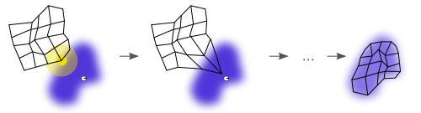
Notes:
Self organizing map

Slide 5
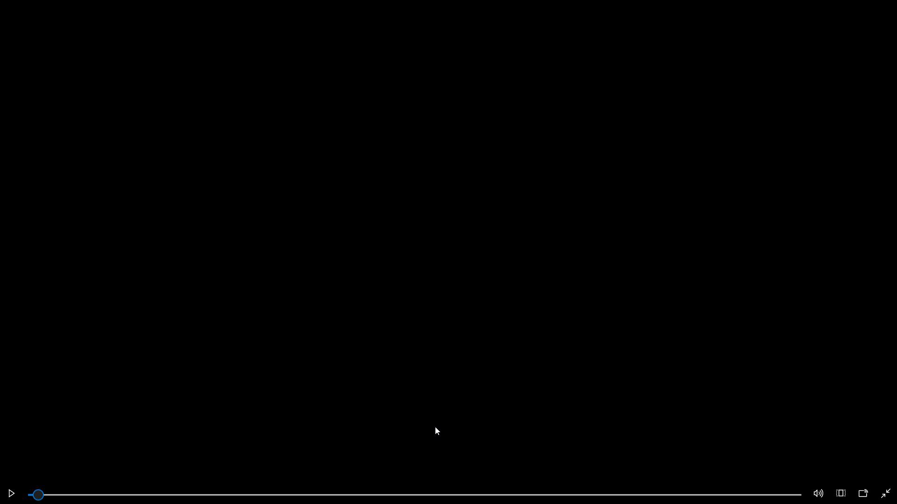

Slide 6
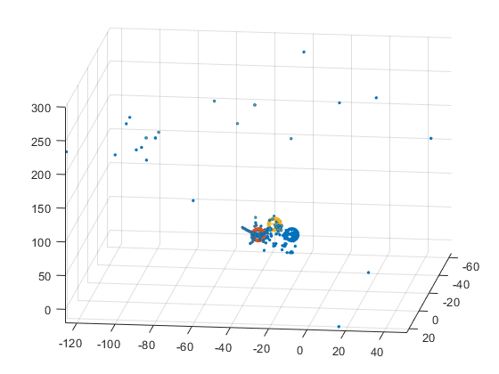
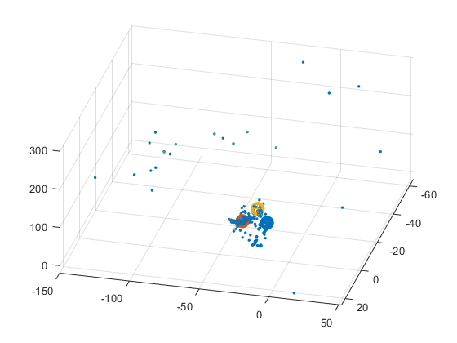

Slide 7
References
https://pdfs.semanticscholar.org/8cb6/fe6ad5879c8a08151481642ba92c2d603596.pdf
https://www.sciencedirect.com/science/article/pii/S0360835212000563

Slide 8
Clustering-Dispersion (Threshold d)
Remove all rows with confidence < 0.6
Run Savitzky-Golay filter (..., 5, 11)
Plot vertical vs horizontal gaze point in degrees
// Pass the coordinates to DBSCAN algorithm and get the clusters
CG = DBSCAN(d, minPoints);
// Variation with BP can be used for adaptive version, eps value changes based on feedback
// Parameters:
ε (eps): 2 degree
minimum number of points required : 10
// Centroid of the clusters in CG gives an estimate of fixation point
For all point P not in any cluster
FindNearestCluster(P, d)
End
GetSaccadeList();
End
Initialize NodeList {};
FindNearestCluster(P, d)
If (P is not in a cluster){
P = point with next timestamp // (P.timestamp++)
If(P is not in NodeList){
NodeList.add(P);
}
FindNearestCluster (P, d);
}
SaccEndPoint1 = P;
If (P is not in a cluster){
P = point with previous timestamp // (P.timestamp++)
If(P is not in NodeList){
NodeList.add(P);
}
FindNearestCluster (P, d);
}
SaccEndPoint2 = P;
end
Initialize tree class T with {node, *left, *right}
FindNearestCluster(Point p, Threshold d)
If(any point in threshold radius around P){
If(Pn does not belong to a cluster){
FindNearestCluster(Point pn, Threshold d)
}
}
Else{
FindNearestCluster(Point p, Threshold d +1)
}
end
Notes:
Density-based spatial clustering of applications with noise (DBSCAN)
Local outlier factor

Slide 9
Velocity
Velocity (Threshold d)
Remove all rows with confidence < 0.6
Run Savitzky-Golay filter (.., 5, 11)
Plot vertical vs horizontal gaze point in degrees
// Pass the XYZ coordinates to DBSCAN algorithm and get the clusters
CG = DBSCAN(d, minPoints);
// Variation with BP can be used for adaptive version, eps value changes based on feedback
// Parameters:
ε (eps): 2 degree
minimum number of points required : 10
// Centroid of the clusters in CG gives an estimate of fixation point
For each cluster C in CG
Plot centroid of C
End
End
Notes:
Density-based spatial clustering of applications with noise (DBSCAN)
Local outlier factor

